Slide 1
PROject progress
Team A4: MD MUBEEN ALI ZAKI (1604-19-733-033)
MIR AHMED ALI YASUBUDDIN (1604-19-733-038)
SYED ARFAAT (1604-19-733-051)
UNDER THE GUIDANCE :
Mrs. Manjusha Kalekuri,
Assistant Professor (PPS Coordinator), MJCET.

Slide 2
DATA COLLECTION

Slide 3
DATA PROCESSING AND CLEANING

Slide 4
ANALYTICS

Slide 5
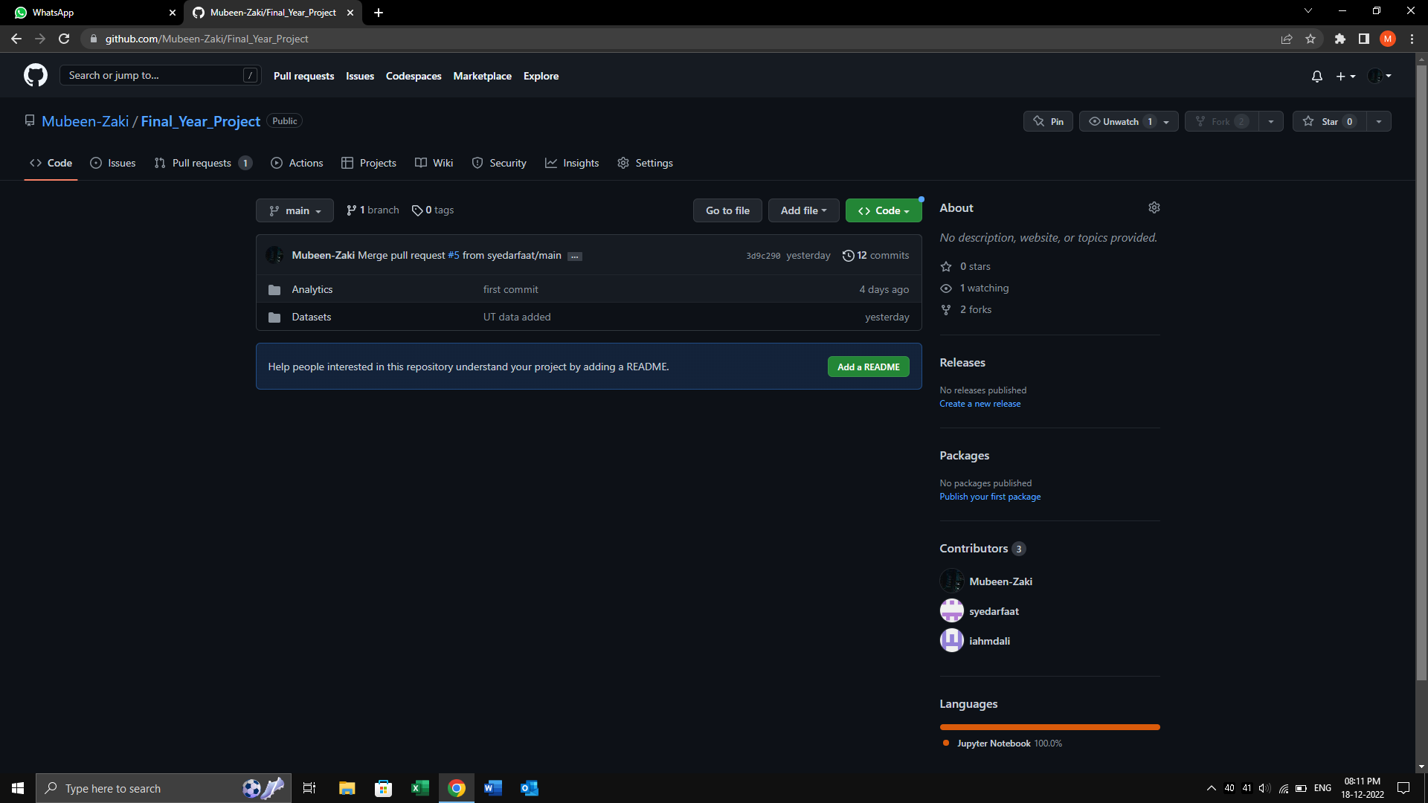
GITHUB REPOSITORY

Slide 6
Thank You

